Slide 1
Network Adequacy
Data Maintenance Planning
10:00 am-11:30 am Central
August 15, 2024
Regulatory Health Link Division,
Arkansas Insurance Dept., Dept. of Commerce

Slide 2
Agenda
Introductions & housekeeping.
Brief recap of July 16, 2024, meeting.
What will be published?
Federal Provider types.
Details on the initial “seed” template.
Timeline.
The challenge of the first review.
Questions.

Slide 3
Agenda
Introductions & housekeeping.
Brief recap of July 16, 2024, meeting.
What will be published?
Federal Provider types.
Details on the initial “seed” template.
Timeline.
The challenge of the first review.
Questions.

Slide 4
Brief recap of July 16, 2024, meeting.
Why AID held back publishing meeting materials and the initial PTNP template for a month?
CMS-CCIIO NA Time and Distance standards applicable PY2026 & AID’s decision to have one NA standard in the state.
AID will participate in the PTNP process for the first time using the APCD and other analysis, just like any other issuer and expects to be subject to the voting process.

Slide 5
Agenda
Introductions & housekeeping.
Brief recap of July 16, 2024, meeting.
What will be published?
Federal Provider types.
Details on the initial “seed” template.
Timeline.
The challenge of the first review.
Questions.

Slide 6
What will be published?
Initial seed template.
Provider-Type taxonomies & other definitions.
NA Process (annual timeline for NA processes) .
Prior meeting artifacts for transparency (Published with a warning about superseded categories).
Current meeting artifacts.

Slide 7
Agenda
Introductions & housekeeping.
Brief recap of July 16, 2024, meeting.
What will be published?
Federal Provider types.
Details on the initial “seed” template.
Timeline.
The challenge of the first review.
Questions.

Slide 8
Federal Provider types
Two changes since July to simplify the PTNP process and make AID more closely aligned with CMS:
PTNP will classify providers by Criteria Code (CMS Requirement Category) rather than by Specialty.
Though Specialty is what is reported by issuers on the NA Template, nothing is gained by subdividing requirements.
45 Criteria as opposed to 66 specialties.
The Arkansas-specific Criteria for “Substance Use Disorder Providers” and “Pharmacies” will not be used this round.
Pharmacies are already evaluated by the PBM regulatory process. May revisit if issuers do not use PBMs.
Federal and Arkansas taxonomic definitions for Substance Use Disorder found to exclude important taxonomies and difficulty in properly identifying appropriate providers; AID will revisit.
Removes need for “Supplemental NA Template” for PY2026

Slide 9
Federal Provider types
Facilities
F001 Acute Inpatient Hospitals
F002 Cardiac Catheterization Services
F003 Cardiac Surgery Program
F004 Critical Care Services
F005 Diagnostic Radiology
F006 Inpatient or Residential Behavioral Health Facility Services
F007 Mammography
F008 Outpatient Infusion/Chemotherapy
F009 Skilled Nursing Facilities
F010 Surgical Services
F011 Urgent Care
Individual
P012 Allergy and Immunology
P013 Cardiology
P014 Cardiothoracic Surgery
P015 Chiropractor
P016 Dental
P017 Dermatology
P018 Emergency Medicine
P019 Endocrinology
P020 ENT/Otolaryngology
P021 Gastroenterology
P022 General Surgery
P023 Gynecology, OB/GYN
P024 Infectious Diseases
P025 Nephrology
P026 Neurology
P027 Neurosurgery
P028 Occupational Therapy
P029 Oncology - Medical, Surgical
P030 Oncology - Radiation
P031 Ophthalmology
P032 Orthopedic Surgery
P033 Outpatient Clinical Behavioral Health
P034 Physical Medicine and Rehabilitation
P035 Physical Therapy
P036 Plastic Surgery
P037 Podiatry
P038 Primary Care – Adult
P039 Primary Care – Pediatric
P040 Psychiatry
P041 Pulmonology
P042 Rheumatology
P043 Speech Therapy
P044 Urology
P045 Vascular Surgery

Slide 10
Federal Provider Types- cont’d
Few Criteria Code (CMS Requirement Category) for facilities do not have taxonomic codes.
Acute Inpatient Hospitals
Cardiac Catheterization Services
Cardiac Surgery Program
Critical Care Services
Use of providers to satisfy network adequacy must adhere to all CMS-CCIIO published restrictions for the applicable plan year.
(For example in CMS-CCIIO’s PY2025 NA Template usage instructions, the inclusion of APRNs and PA into all specialties is not allowed unless specified otherwise – as for PCP and Behavioral Health under special circumstances)

Slide 11
Agenda
Introductions & housekeeping.
Brief recap of July 16, 2024, meeting.
What will be published?
Federal Provider types.
Details on the initial “seed” template.
Timeline.
The challenge of the first review.
Questions.

Slide 12
Details on the initial “seed” template
The Initial Provider Type NPI Pool Template remains largely the same.
Issuer interaction with the template is unchanged.
Informational columns are added:
Number of Issuer Groups including the NPI in that criteria
Last claim date found
Potential AID action to delete based on claim history and classification
Informational sheet added:
Summary of misclassifications found
Provider Type Taxonomies sheet updated to include specialty and taxonomy breakdown from Federal NA Template

Slide 13
Details on the initial “seed” template

Slide 14
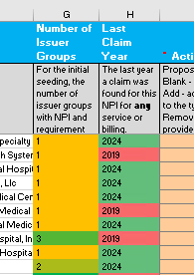
Details on the initial “seed” template

Slide 15
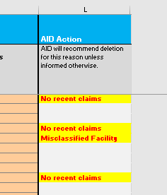
Details on the initial “seed” template

Slide 16
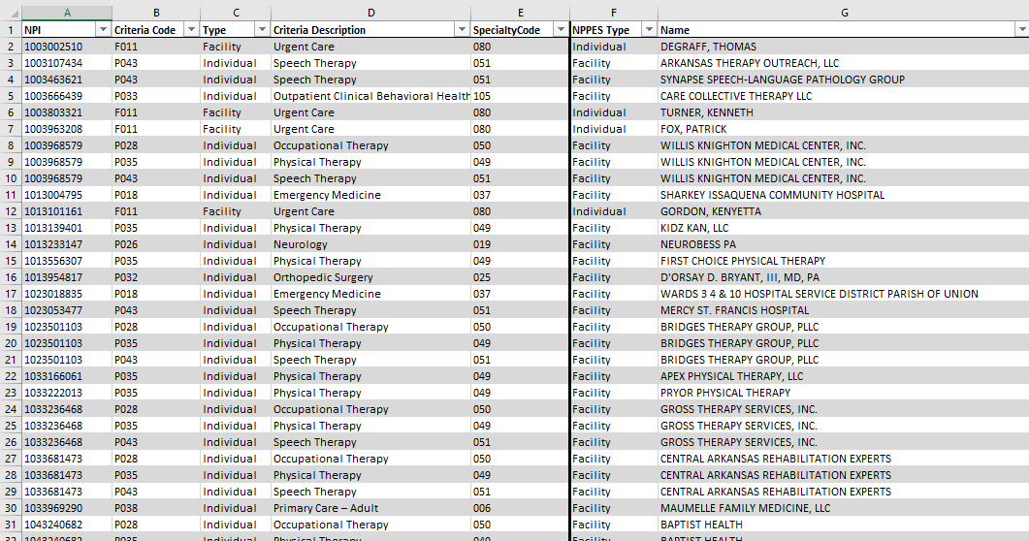
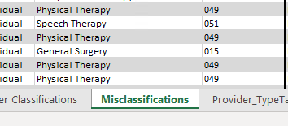
Details on the initial “seed” template

Slide 17
Differences In Classification

Slide 18
Differences In Classification

Slide 19
Differences In Classification

Slide 20
Differences In Classification

Slide 21
Agenda
Introductions & housekeeping.
Brief recap of July 16, 2024, meeting.
What will be published?
Federal Provider types.
Details on the initial “seed” template.
Timeline.
The challenge of the first review.
Questions.

Slide 22
Timeline – PTNP rounds & certification review
We are engaged in this round
Last round before we go live with CCIIO T&D stds
PTNP Round 2 of 2024
PTNP Round 1 of 2025
Certification Review for PY2026
mid-July, 2024
mid-Nov, 2024
mid-Dec, 2024
mid-March, 2025
mid-May, 2025
Jan 1, 2026

Slide 23
Dealing with AID’s delay
We are engaged in this round and have got delayed…
Last round before we go live with CCIIO T&D stds
PTNP Round 2 of 2024
PTNP Round 1 of 2025
Certification Review for PY2026
mid-July, 2024
Early Dec, 2024
Early-Dec, 2024
mid March, 2025
mid-May, 2025
Jan 1, 2026

Slide 24
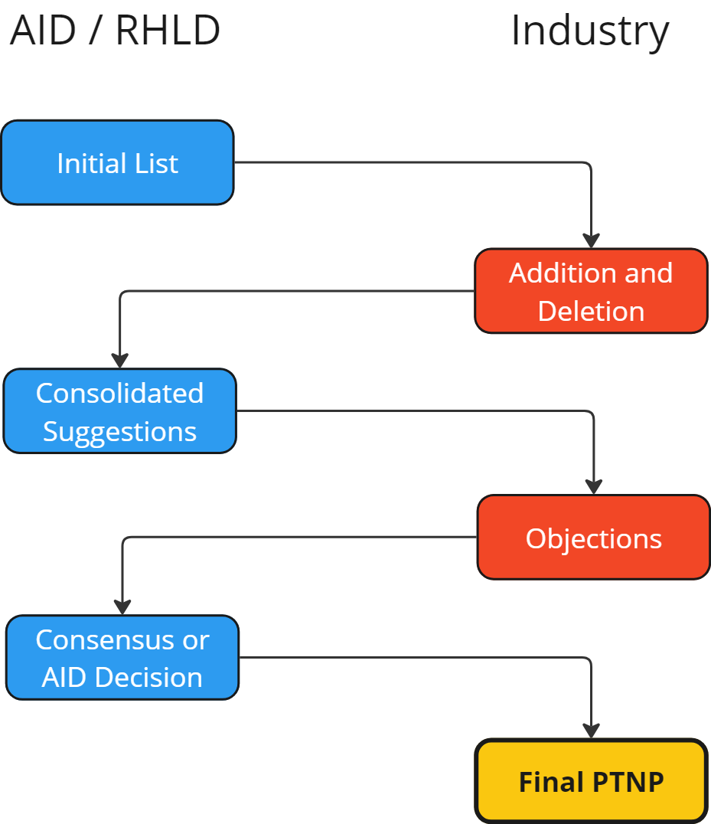
Processes In Each PTNP Round
Stage 1
Stage 2

Slide 25
PTNP Round 2 of 2024 (First cut of Federal Requirements)
Issuers & AID meet
Issuers & AID meet
Stage 1 (Issuers suggesting changes)
40 days
13 days
Stage 2 (Issuers voting)
42 days
28 days
8/15/2024-Initial template published
9/24/2024
Add/Delete Suggestions from Issuer
10/7/2024
Consolidated suggestions by AID
11/18/2024 Votes from Issuers
12/16/2024
Finalized PTNP by AID

Slide 26
PTNP Round 1 of 2025 (First cut of Federal Requirements)
Stage 1 (Issuers suggesting changes)
30 days
16 days
Stage 2 (Issuers voting)
28 days
14 days
12/16/2024-Initial template published
1/15/2025
Add/Delete Suggestions from Issuer
1/31/2025
Consolidated suggestions by AID
2/28/2025 Votes from Issuers
3/14/2025
Finalized PTNP by AID

Slide 27
Agenda
Introductions & housekeeping.
Brief recap of July 16, 2024, meeting.
What will be published?
Federal Provider types.
Details on the initial “seed” template.
Timeline.
The challenge of the first review.
Questions.

Slide 29
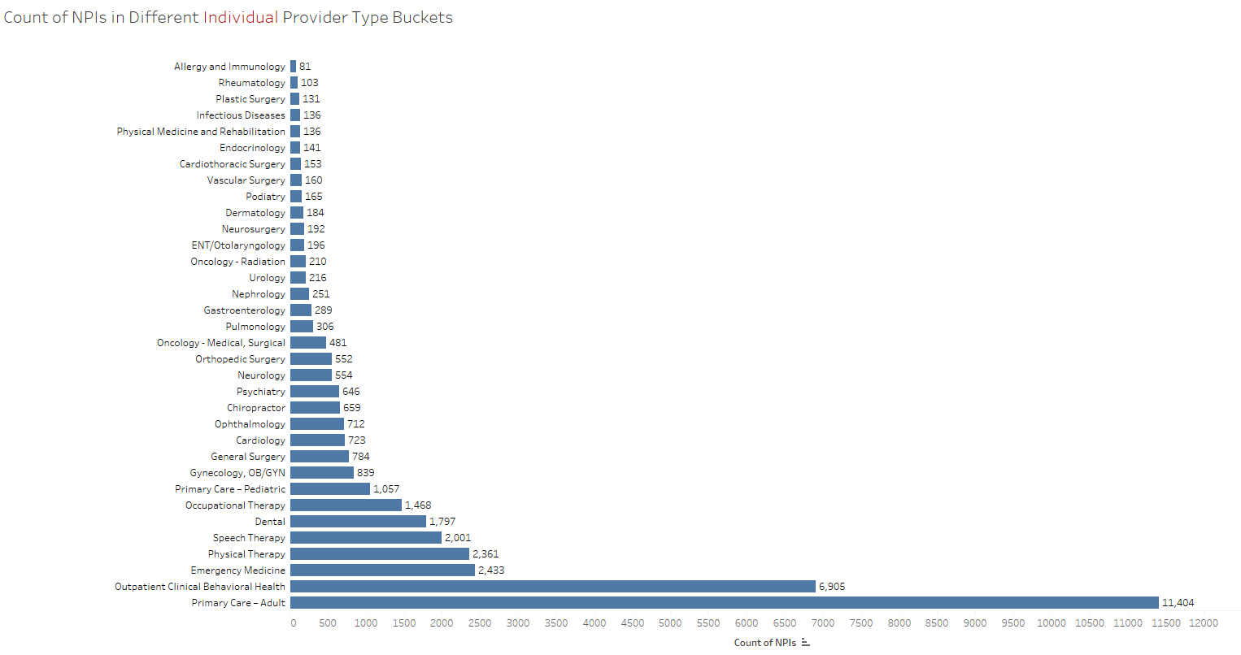
Individual Provider Type Profile

Slide 30
Facility Provider Type Profile

Slide 31
The challenge of the first review.
Over 41K rows of provider NPI- ProviderType combo to be reviewed in 40 calendar days – how well can this be done?
Suggest gathering your best available data analysts around the claims and provider network domains and explain the challenge to them
Explain the need to them “Need industry consensus on correct provider classification irrespective provider being inside or outside the company’s network(s).”
Provide the initial seed templates & solicit ideas on how best to approach the challenging number of providers and triage the NPIs to review.
Collaboration between issuers needed. AID willing to host issuer meetings within its premises if required.
AID suggests prioritization of PTNP review with sparse provider types first.
AID will help in the triage of potential NPI (mis)classifications as best as it can.
Based on the APCD -will issue deletion suggestions based on lack of claims since 2022.
Will issue deletion suggestions based on facility-individual misclassification by 1 issuer group.
The two bullets are flagged in the initial “seed” list.
Will provide each issuer group a triage report customized for the issuer group.

Slide 32
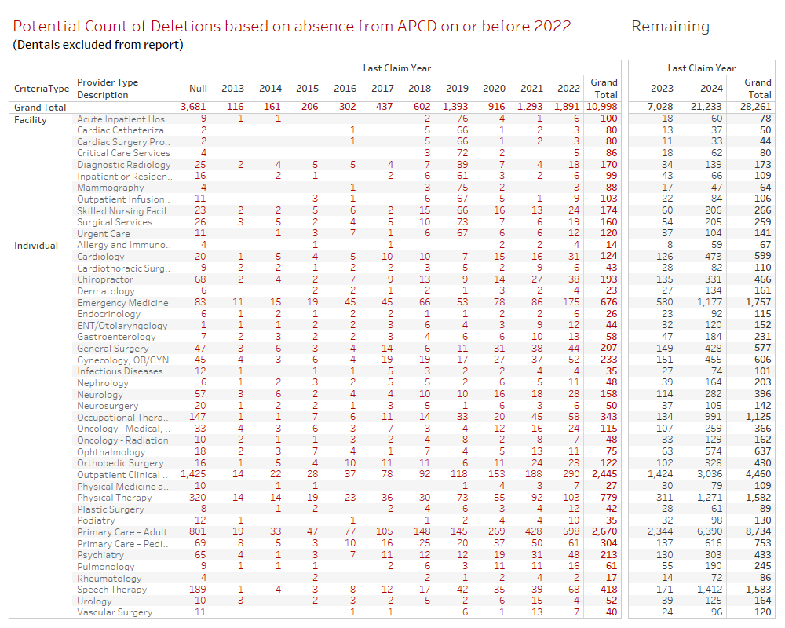

Slide 33
Questions?
Email
RHLD.DataOversight@arkansas.gov

